Slide 1
Professional Skills by Marco Pinna University of Lincoln

Slide 2
Poster
What is the purpose of your poster - to report findings, present an argument, convince an audience or promote a product?
Who will be looking at your poster - a specialist audience, the general public, other students?
What will your audience be looking for - detailed information or a brief summary?
Where will your poster be displayed - in a busy conference hall or in your department?
Are there any guidelines governing the content of your poster? These might specify the nature and structure of the material to be displayed (as well as practical issues such as the size of the poster and the size and amount of text to be used).

Slide 3
Presentation of your text
There are five main variables to consider
Font - Type size - remember that your poster will be read by someone standing at about a metre away so the text will need to be legible at a distance. Use large type sizes; the following examples are at 24 point and 36 point and can be clearly read at a distance.
Line spacing or 'leading’ - using one and a half or double spacing between lines of text greatly increases the legibility of your poster design.
Font - Type size - remember that your poster will be read by someone standing at about a metre away so the text will need to be legible at a distance. Use large type sizes; the following examples are at 24 point and 36 point and can be clearly read at a distance.
Alignment - Diagrams - Displaying information on a poster gives you an opportunity to represent your data in an interesting and eye-catching way. Think about how your display can be enhanced through the use of illustrations, table charts or photographs.

Slide 4
Structure
Your overall structure should be clear and logical so that the viewer’s eye naturally follows the flow of information in your display. To help establish a clear sequence of information, think about planning your poster on a grid system.

Slide 5
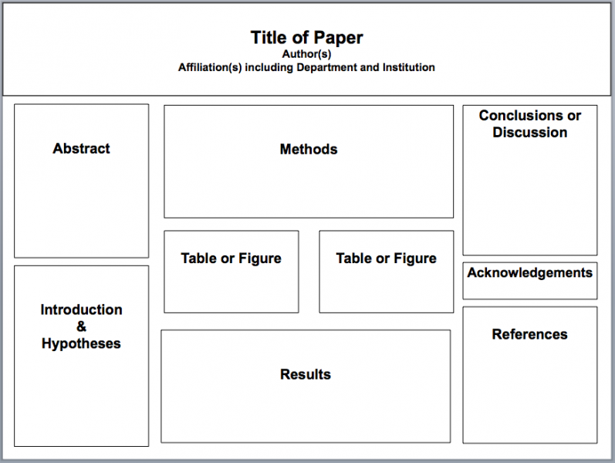

Slide 6
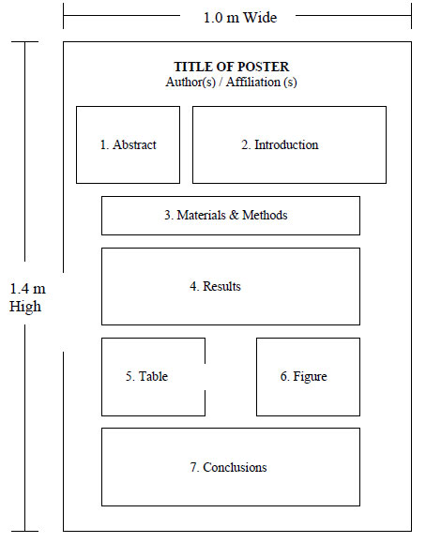

Slide 7
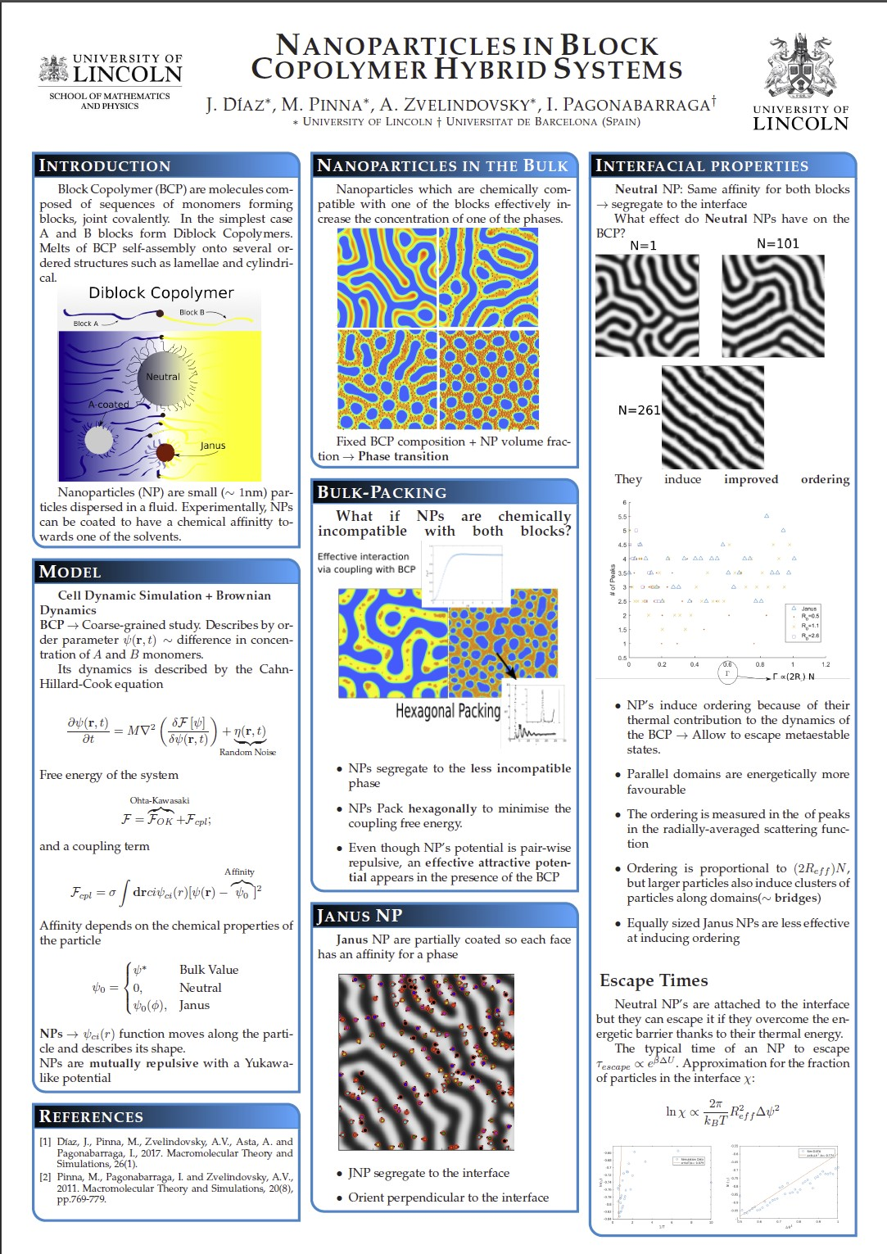

Slide 8
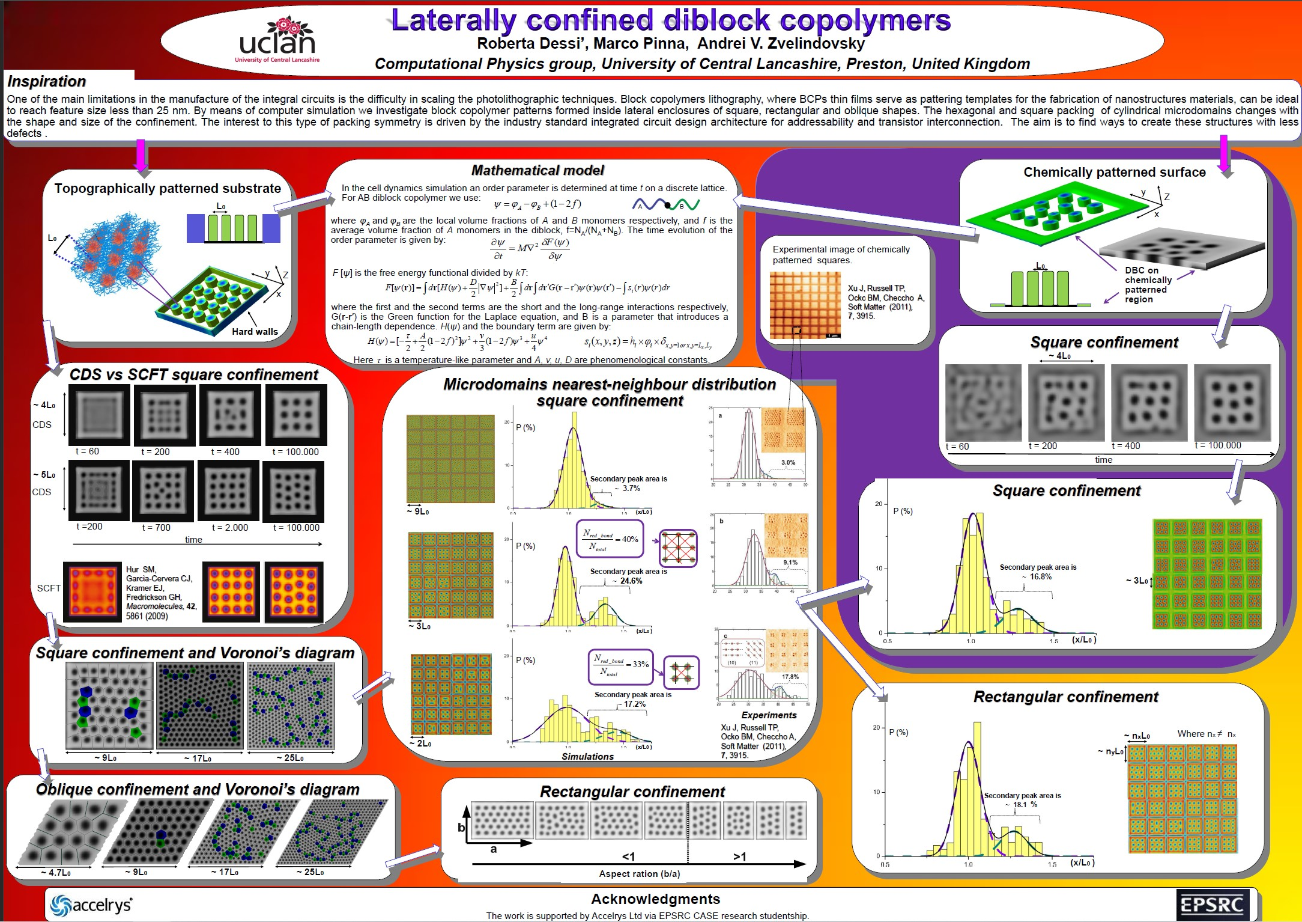

Slide 9
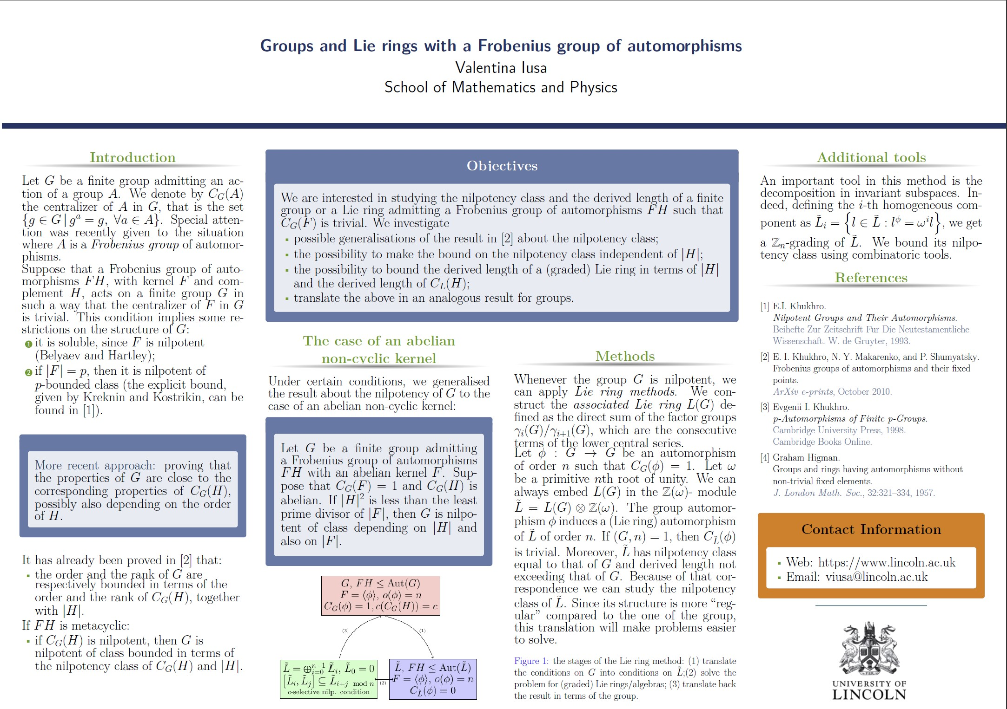

Slide 10
END

